Slide 1
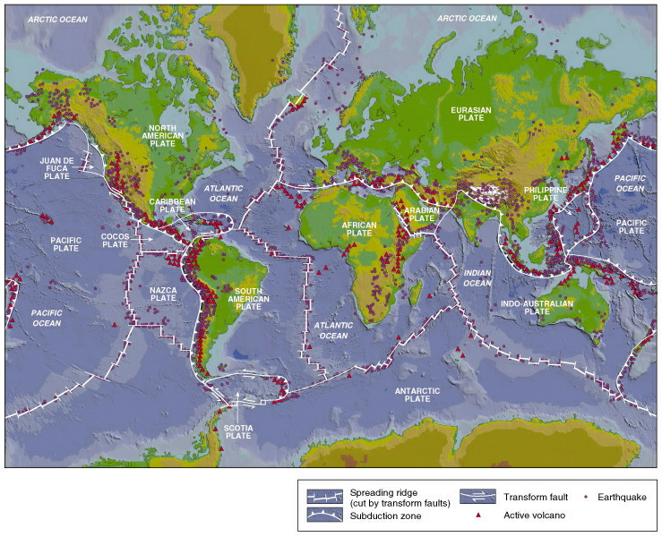
CHAPTER 8
OUR DYNAMIC PLANET

Slide 2
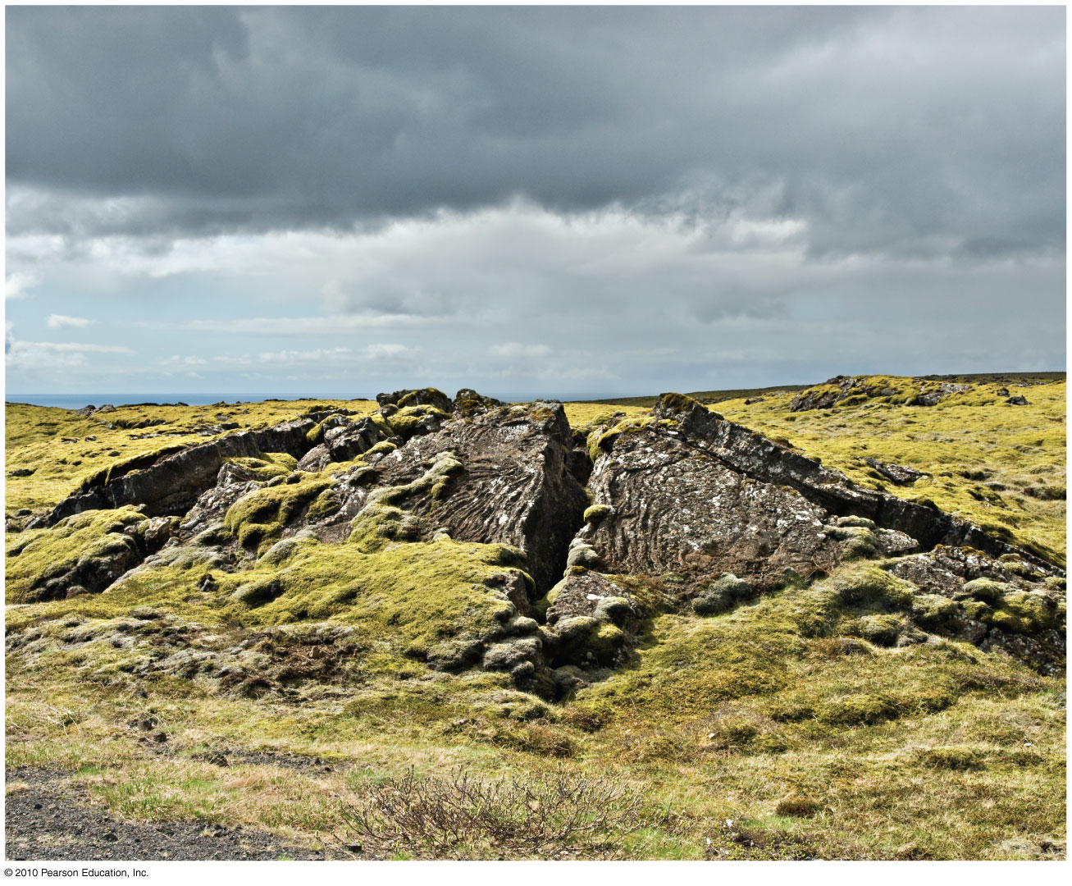
OUR DYNAMIC PLANET: both endogenic and exogenic systems
operate on and within Earth giving rise to our landscapes
as we see it today

Slide 3
The Dynamic Planet
The Pace of Change
Earth’s Structure and Internal Energy
The Geologic Cycle
Plate Tectonics

Slide 4
The Pace of Change
Geologic Time Scale
A summary timeline of all Earth’s history
Earth is 4.6 billion years old
Based on relative positions of rock strata above or below each other – relative time
Law of superposition – youngest beds are on the top, older beds at the base
Both relative and absolute dating used today
Uniformitarianism
The same physical processes that are active in the environment today have been operating throughout geologic time
The present is the key to the past

Slide 5
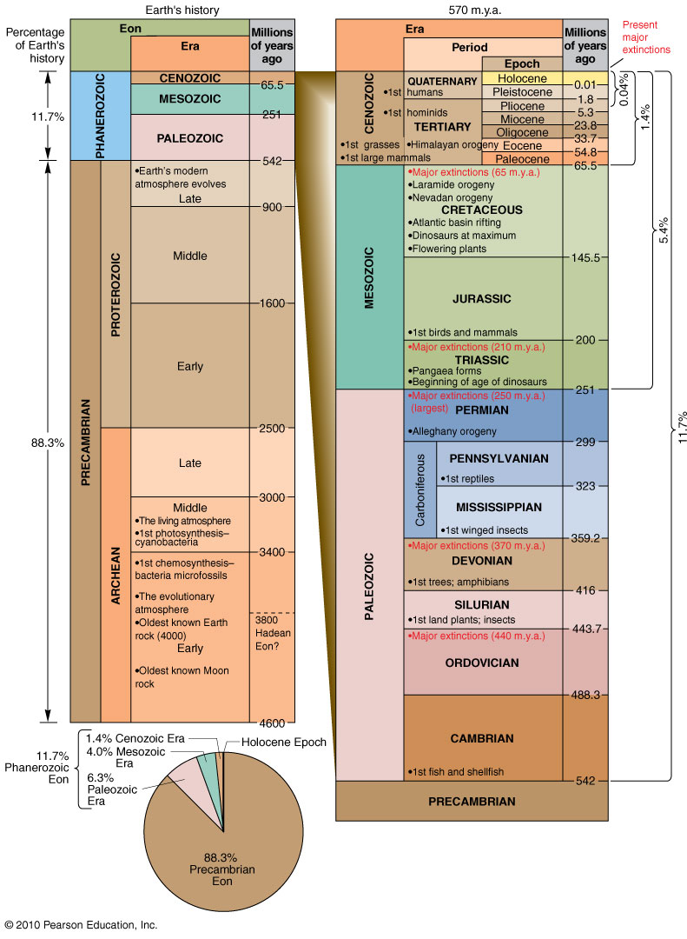
Geologic Time Scale
Figure 8.1
Christopherson, Elemental Geosystems, Sixth Edition
Copyright © 2010 Pearson Education, Inc.

Slide 6
Earth’s Structure and Internal Energy
Earth in Cross Section
Earth’s core
Earth’s magnetism
Earth’s mantle
Lithosphere and crust

Slide 7
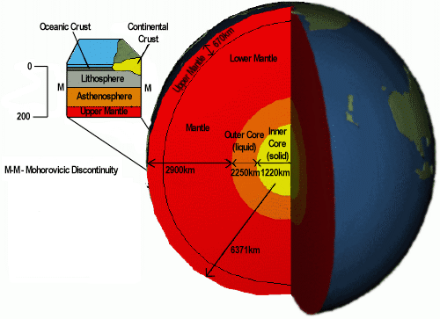

Slide 8
The Core
Origin
Most accepted explanation is that the core formed early in Earth’s history from a relatively homogeneous body
Blobs of heavy iron-rich materials sank toward the centre as Earth’s internal temperature increased
As Earth began to cool, iron in the core began to crystallize and the inner core began to form

Slide 9
Earth’s Structure and Internal Energy
Outer Core
Molten, metallic iron with a lighter density than the inner core
Generates about 90% of the Earth’s magnetic field and the magnetosphere that surrounds and protects Earth from the the solar wind
Inner Core
Composed mostly of an iron-nickel alloy
Sphere with a radius of 3486 kilometres
Material is stronger than the outer core
Behaves like a solid

Slide 10
The Core
Earth’s Magnetic Field
The requirements for the core to produce Earth’s magnetic field are met in that it is made of material that conducts electricity and it is mobile
Inner core rotates faster than the Earth’s surface and the axis of rotation is offset about 10 degrees from the Earth’s poles – influences circulation patterns in the outer core, which generates electric currents
The convective circulation generates electrical currents, which induces the magnetic field
Geomagnetic reversal
Occur 9 times during the past 4 million years
Average period of magnetic reversal – 500,000 years

Slide 11
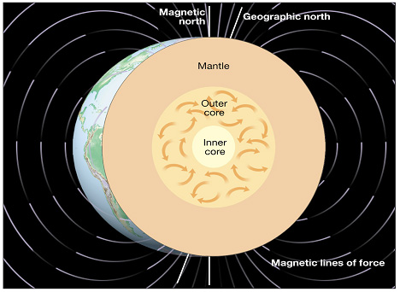
Possible origin of Earth’s magnetic field
The Core

Slide 12
Earth’s Structure and Internal Energy
Mantle:
Represents 80% of earth’s total volume
Rich in oxides of iron, magnesium and silicates
Denser and tightly packed at depth, grading to lesser densities toward the surface
The Gutenberg discontinuity at 2900km is the transition zone between the core and mantle

Slide 13
Earth’s Structure and Internal Energy
3 fairly distinct layers divide the upper mantle:
The uppermost mantle, along the with the crust make up the lithosphere
Asthenosphere (weak sphere)
Beneath the lithosphere, in the upper mantle from about 70km down to 250km
Small amount of melting in the upper portion mechanically detaches the lithosphere from the layer below allowing the lithosphere to move independently of the asthenosphere
Least rigid region of the mantle
About 10% of the asthenosphere is molten in asymmetrical patterns and hot spots
The rest of the upper mantle

Slide 14
Earth’s Structure and Internal Energy
Lower Mantle
Rigid layer between the depths of 660 kilometres and 2900 kilometres
Rocks are very hot and capable of very gradual flow
Consists of olivine, iron/magnesium silicates
A broad transition zone separates the upper mantle form the lower mantle

Slide 15
Earth in Cross Section
Lithosphere & crust (rock sphere)
Earth’s outermost layer, represents only 0.1% of the Earth’s mass
Consists of the crust and uppermost mantle
Boundary between the crust and high-velocity lithospheric upper mantle is called the Mohorovicic discontinuity
Relatively cool, rigid shell
Crustal thickness beneath mountain masses ~ 50 - 60km; beneath continental interiors – 30km; oceanic crusts averages 5km
crust consists of continental and oceanic

Slide 16
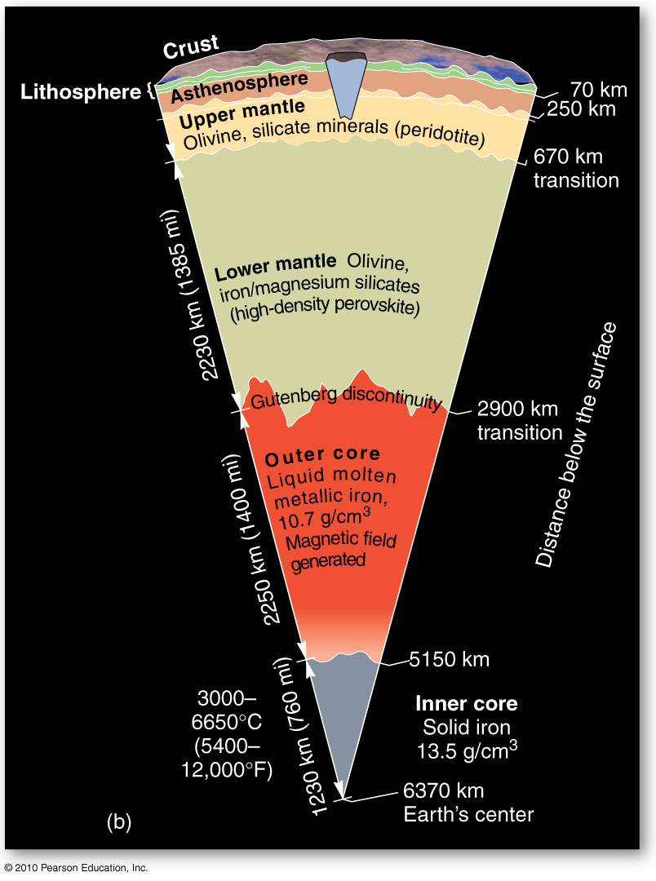
Earth’s Interior
Figure 8.2
Christopherson, Elemental Geosystems, Sixth Edition
Copyright © 2010 Pearson Education, Inc.

Slide 17
Earth’s Structure and Internal Energy
Continental crust
Predominantly igneous rock – granite
Low density – 2.7 g/cm³
SIAL – silica and aluminum
potassium, sodium, calcium
Oceanic crust
Predominantly basalt
Denser than continental crust - 3.0 g/cm³
SIMA – silica and magnesium & iron

Slide 18
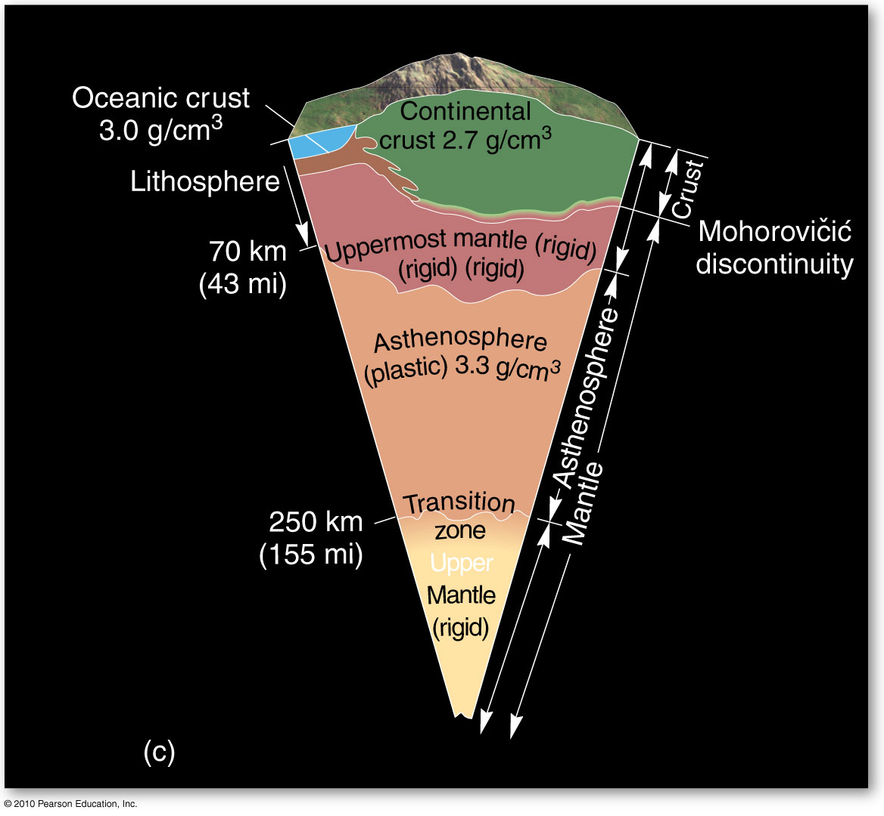
Earth’s Interior
Figure 8.2
Christopherson, Elemental Geosystems, Sixth Edition
Copyright © 2010 Pearson Education, Inc.

Slide 19
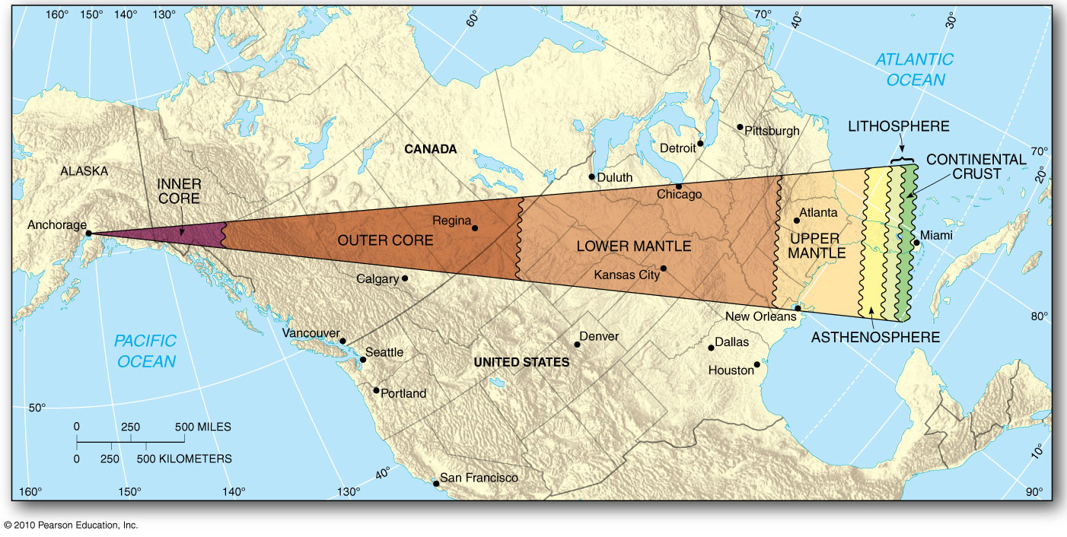
Core to Crust
Surface map, using the distance from St. John’s to Prince Rupert, to compare the
Distance from Earth’s centre to the surface - 6370 km
Figure 8.3

Slide 20
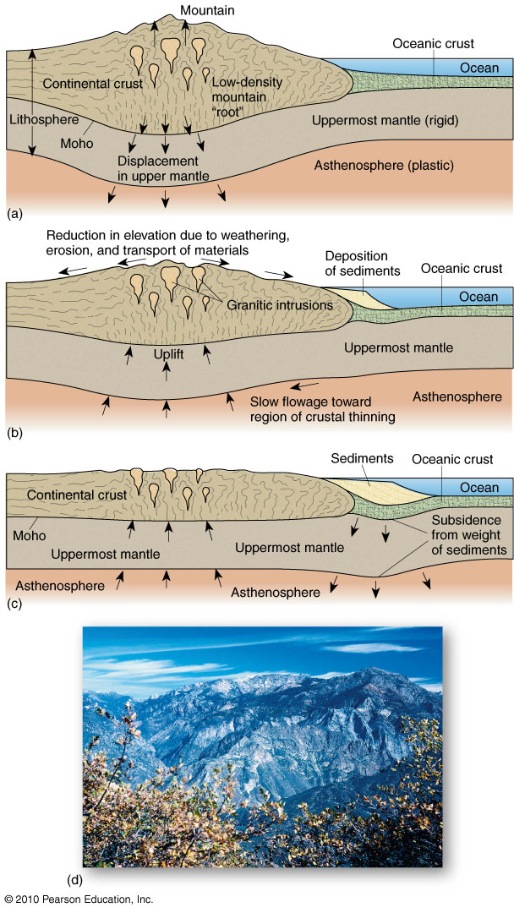
Isostatic Adjustment of the Crust
Explains the vertical
movements of Earth’s
crust
Portions of the Sierra Nevada
Batholith of western U.S.
Figure 8.4
Christopherson, Elemental Geosystems, Sixth Edition
Copyright © 2010 Pearson Education, Inc.

Slide 21
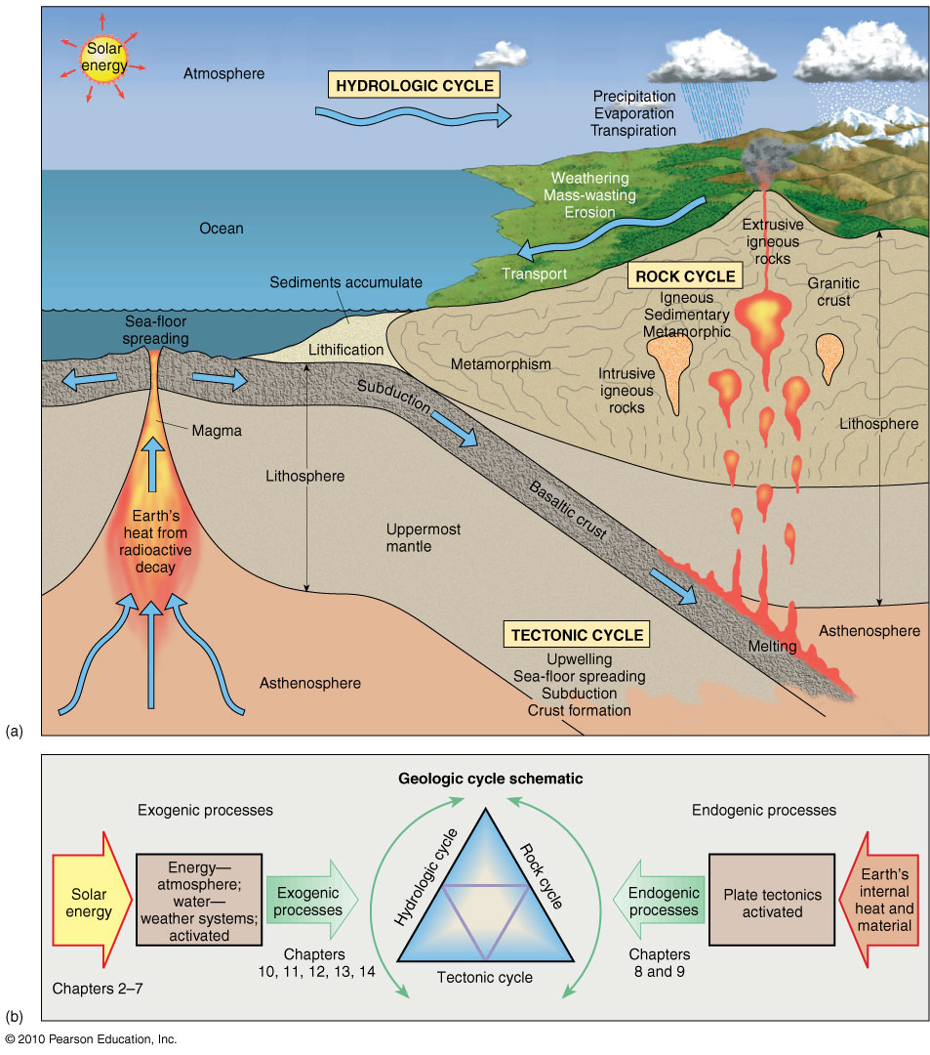
The Geologic Cycle
Exogenic system
Endogenic system
Hydrologic cycle
Rock cycle
Tectonic cycle
Figure 8.5
Christopherson, Elemental Geosystems, Sixth Edition
Copyright © 2010 Pearson Education, Inc.

Slide 22
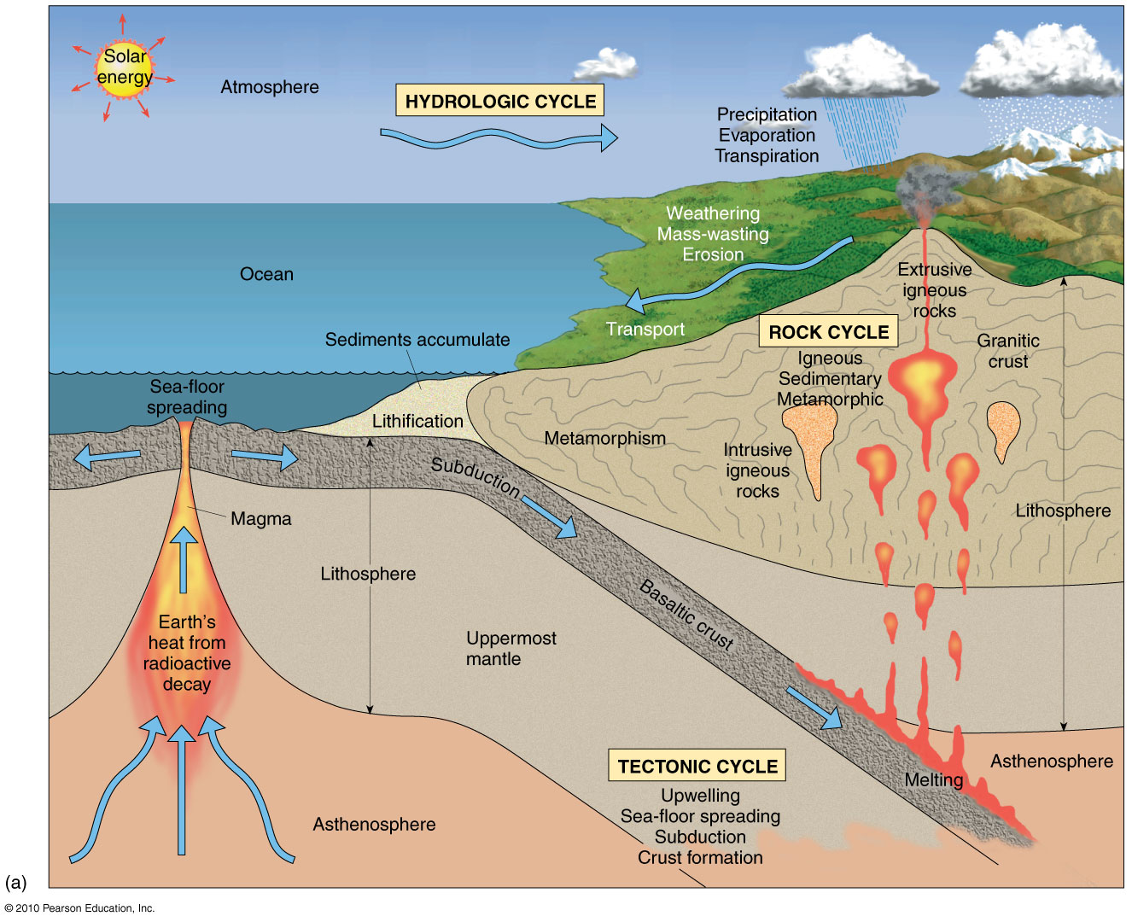

Slide 23
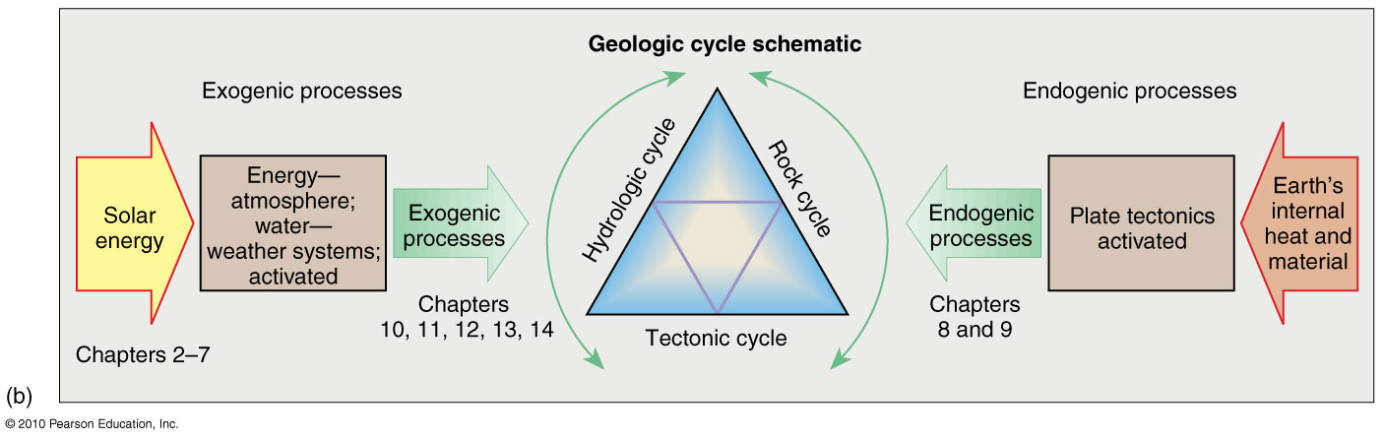

Slide 24
The Geologic Cycle
The Rock Cycle
eight natural elements compose 99% of the earth’s crust
elements combine to form minerals
Of the 4200 minerals known, only 30 comprise the rock forming minerals
A mineral is a naturally occurring, inorganic compound with a specific chemical formula and possesses a crystalline structure
A rock is an assemblage of minerals bound together (granite), or a mass of a single mineral (rock salt), or undifferentiated material (obsidian) or a solid organic material (coal)

Slide 25
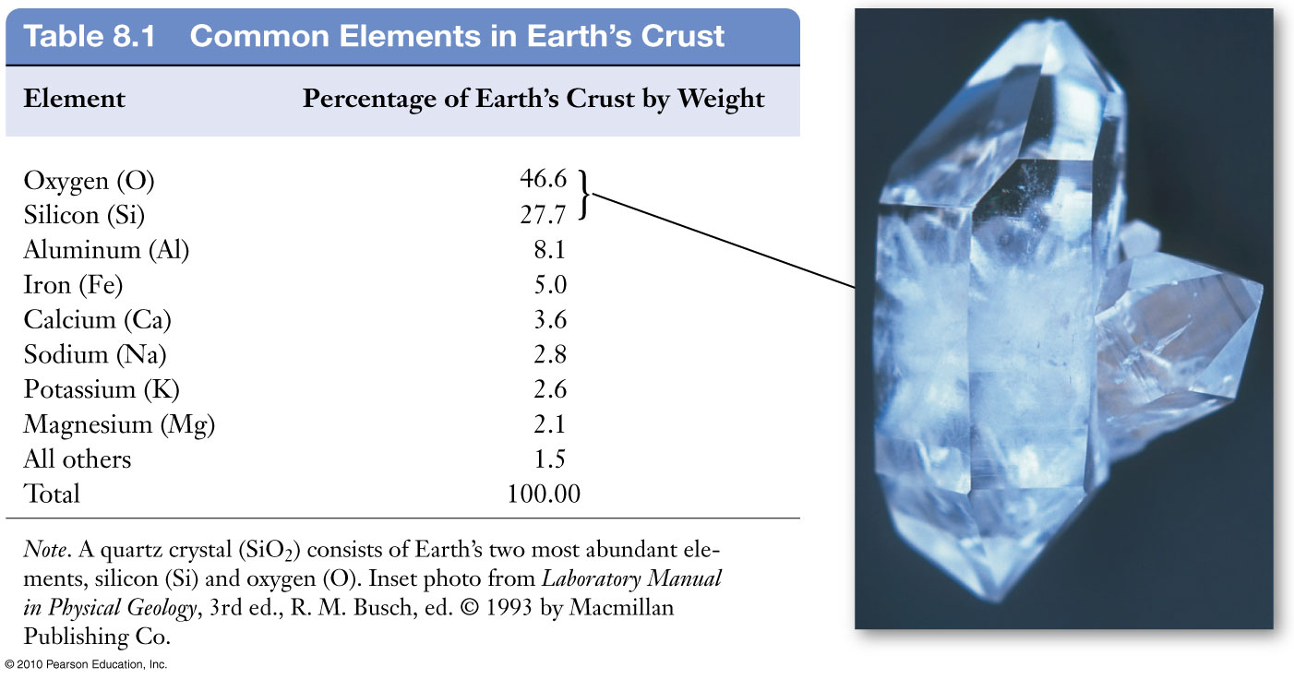
Christopherson, Elemental Geosystems, Sixth Edition
Copyright © 2010 Pearson Education, Inc.

Slide 26
The Geologic Cycle
Igneous processes
Form igneous rocks
Sedimentary processes
Form sedimentary rocks
Metamorphic processes
Form metamorphic rocks

Slide 27
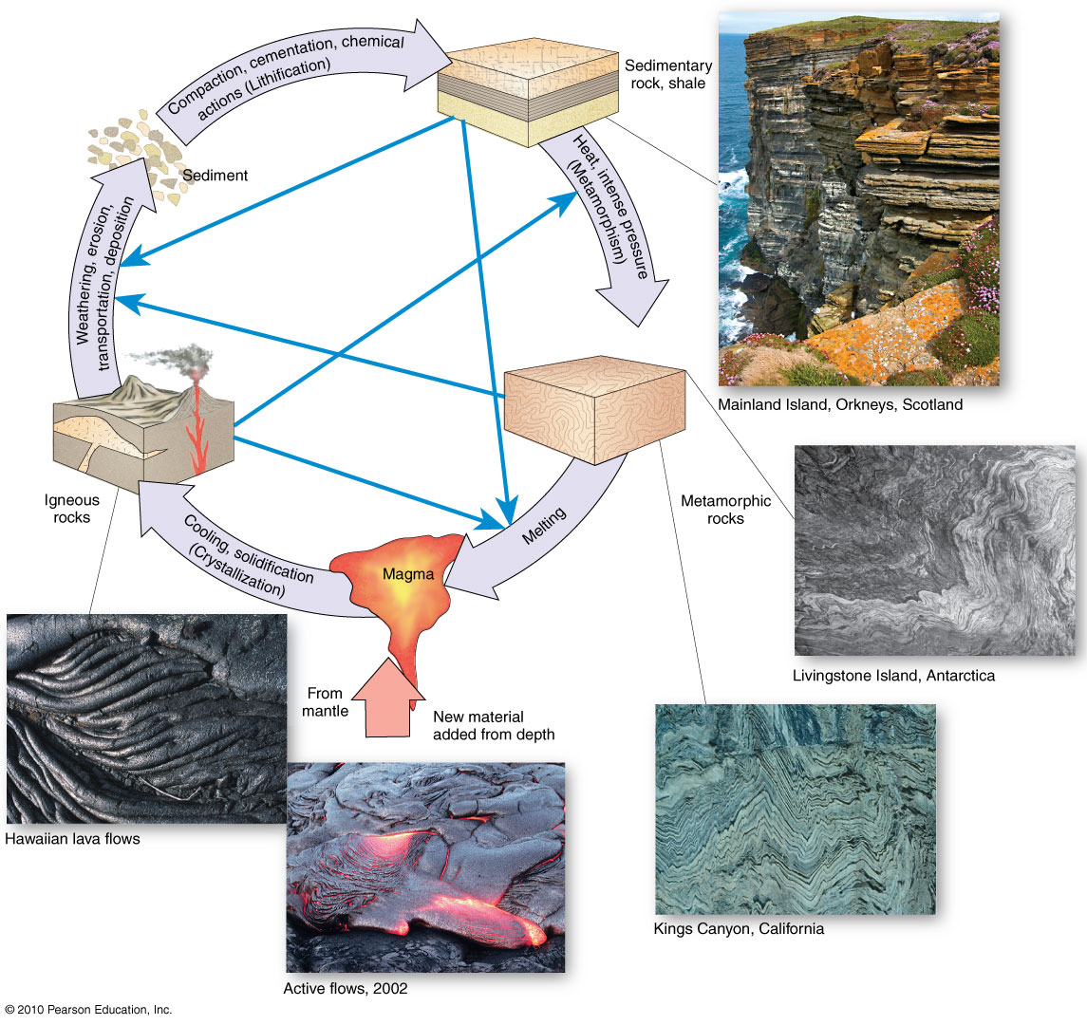
The Rock Cycle
Figure 8.6
Christopherson, Elemental Geosystems, Sixth Edition
Copyright © 2010 Pearson Education, Inc.

Slide 28
The Rock Cycle
Igneous rocks form as molten rock cools and solidifies
General Characteristic of magma
Parent material of igneous rocks
Forms from partial melting of rocks inside the Earth
Magma that reaches the surface is called lava
Fluid, highly gaseous and under tremendous pressure

Slide 29
Magma: The Parent Material of Igneous Rock
General Characteristic of Magma
Rocks formed from lava at the surface are classified as extrusive, or volcanic rocks
Rocks formed from magma that crystallizes at depth are termed intrusive, or plutonic rocks
plutons >100km² is called a batholith

Slide 30
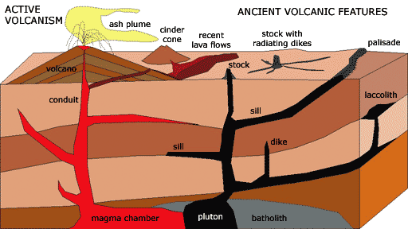

Slide 31
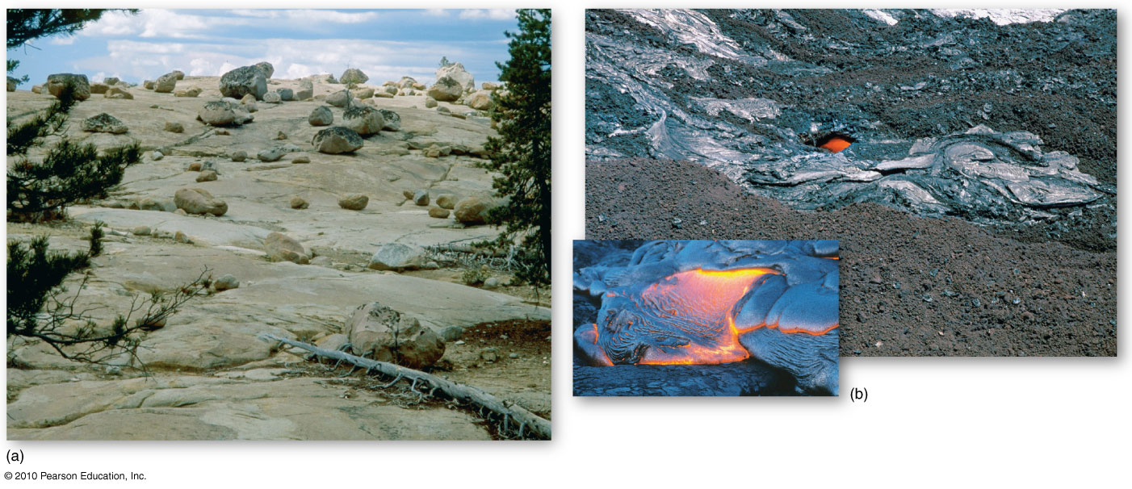
Intrusive and Extrusive Rocks
Basaltic lava flows on Hawaii
Granites of the Sierra Nevada
Batholith
Figure 8.8

Slide 32
Sedimentary rocks
Formed by the process of weathering or derived from organic materials such as shells or bone
Weathering – the physical breakdown and chemical alteration of rocks and minerals at or near earth’s surface
Acts on parent material which is disaggregated to form smaller fragments
Much of this material is either accumulated to form soil or removed by erosion

Slide 33
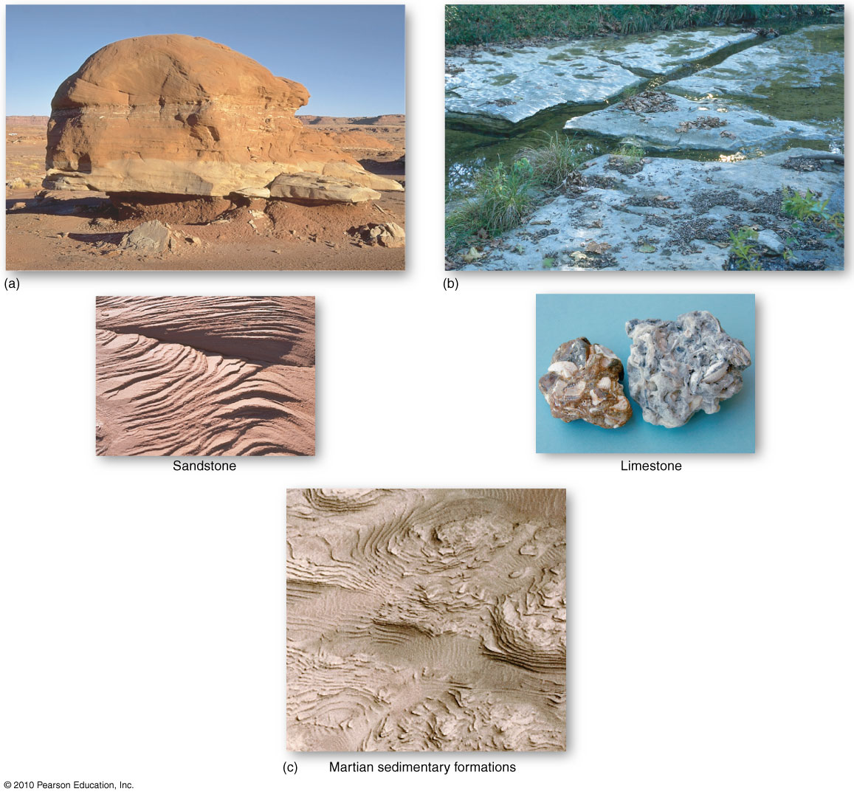
Sedimentary Rock Types
Figure 8.9
Christopherson, Elemental Geosystems, Sixth Edition
Copyright © 2010 Pearson Education, Inc.

Slide 34
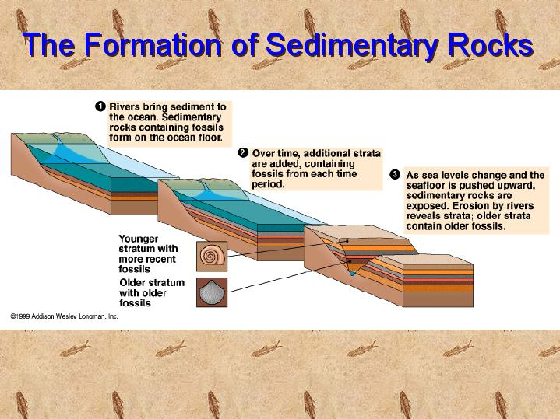

Slide 35
Sedimentary rocks
Sediment is deposited in flat, horizontal layers with the oldest layers on the bottom and the younger layers laying on top – law of superposition
Geologists use this knowledge to read layers of sedimentary rock like the pages in a book
Stratigraphy – the study of the layers of rocks
thickness, spatial distribution, composition
They can date layers by the fossils that are found in them
If a layer has a fossil in it that is known to be 50 million years old the layer itself must be at least 50 million years old and the layers below it have to be older than 50 million years – law of fossil succession

Slide 36
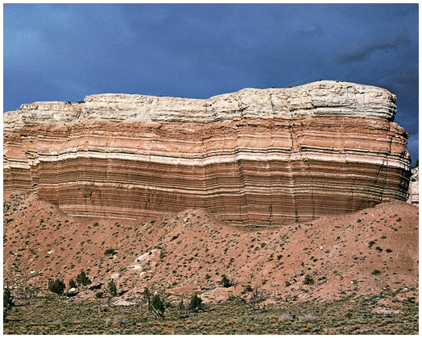
Sedimentary layers
TALUS

Slide 37
Sedimentary Rock
Sedimentary rocks are products of mechanical (clastic sediments) and chemical weathering (chemical sediments)
They account for about 5 percent (by volume) of Earth’s outer 16 kilometres
Contain evidence of past environments
Provide information about sediment transport
Often contain fossils

Slide 38
Turning Sediment into Sedimentary Rock
Many changes occur to sediment after it is deposited
Diagenesis – all of the chemical, physical, and biological changes that take place after sediments are deposited, but prior to metamorphism
Occurs within the upper few kilometres of Earth’s crust at temperatures generally less than 200ºC

Slide 39
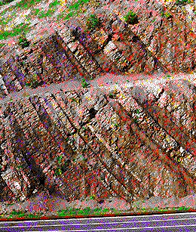
Lithification:
Compaction
Cementation
Recrystallization

Slide 40
Sedimentary Rocks
Composed of particles of gravel, sand, silt, & clay
Pressure & cementing processes cause rocks to form
Large particles form conglomerates
Sand forms sandstone
Silt & clay form shale or siltstone
Organic materials form limestone or coal

Slide 41
Types of Sedimentary Rocks
Sediment originates from mechanical and/or chemical weathering
Rock types are based on the source of the material
Detrital or clastic sedimentary rocks – weathered and fragmented transported sediment as solid particles – mudstone, shale, siltstone, sandstone
Chemical sedimentary rocks – sediment that was once in solution- limestone (calcium carbonate) , evaporites (table salt), hydrothermal activity (black smokers)

Slide 42
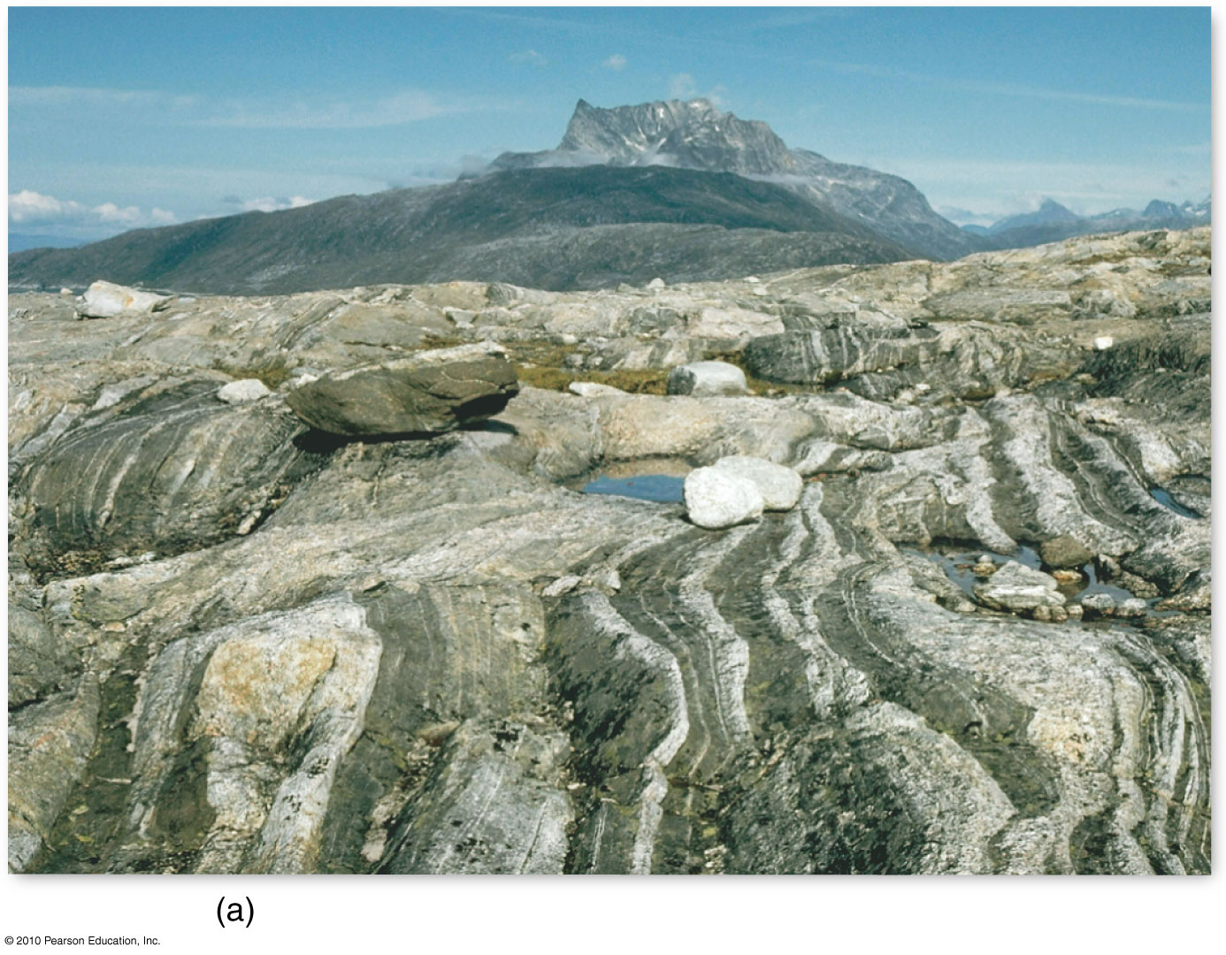
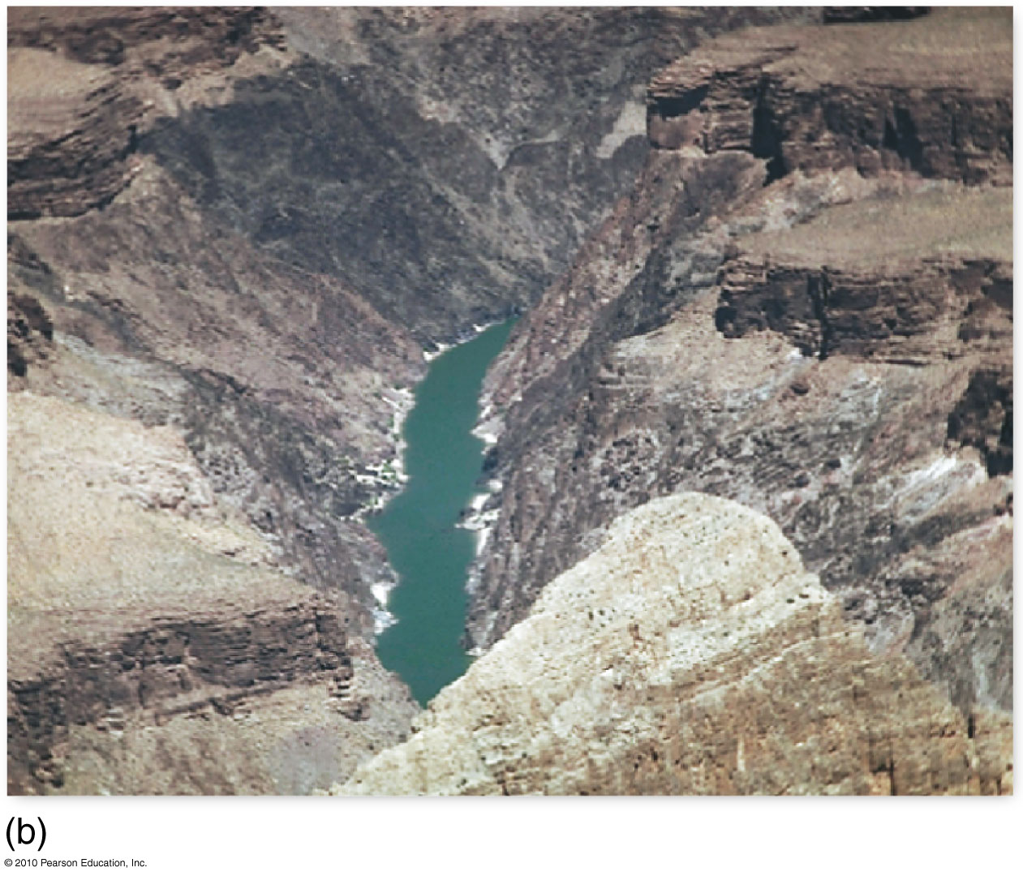
Metamorphic Rocks
Figure 8.12

Slide 43
Metamorphism
The transition of one rock into another by temperatures and/or pressures unlike those in which it formed
Metamorphic rocks are formed from
Igneous rocks
Sedimentary rocks
Other metamorphic rocks

Slide 44
Agents of Metamorphism
Temperature (heat)
The most important agent
Chemical reactions and re-crystallization result in new minerals that are stable for the new conditions
Two sources of heat
Intrusive igneous body baking surrounding rocks
Earth’s internal heat when brought to great depth

Slide 45
Agents of Metamorphism
Pressure (stress)
Increases with depth
Confining pressure (uniform stress) applies forces equally in all directions; harder and denser metamorphic rocks
Rocks may also be subjected to directed pressure (differential stress), which is unequal in different directions

Slide 46
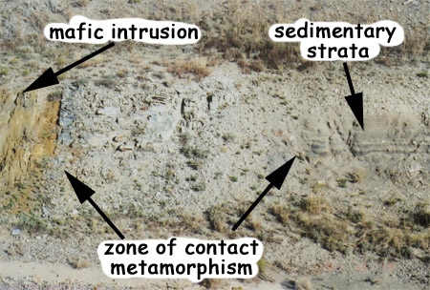
CONTACT METAMORPHISM

Slide 47
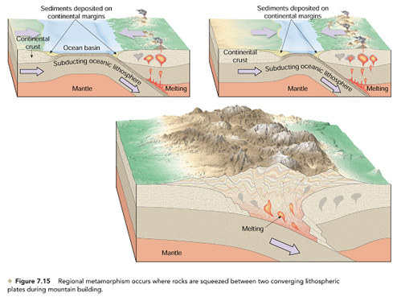
Metamorphic Environments and Rocks
Regional metamorphism occurs where rocks are squeezed between converging plates.

Slide 48
Plate Tectonics
A Brief History
Sea-Floor Spreading and Production of New Crust
Subduction of Crust
The Formation and Breakup of Pangaea
Plate Boundaries
Earthquakes and Volcanoes
Hot Spots

Slide 49
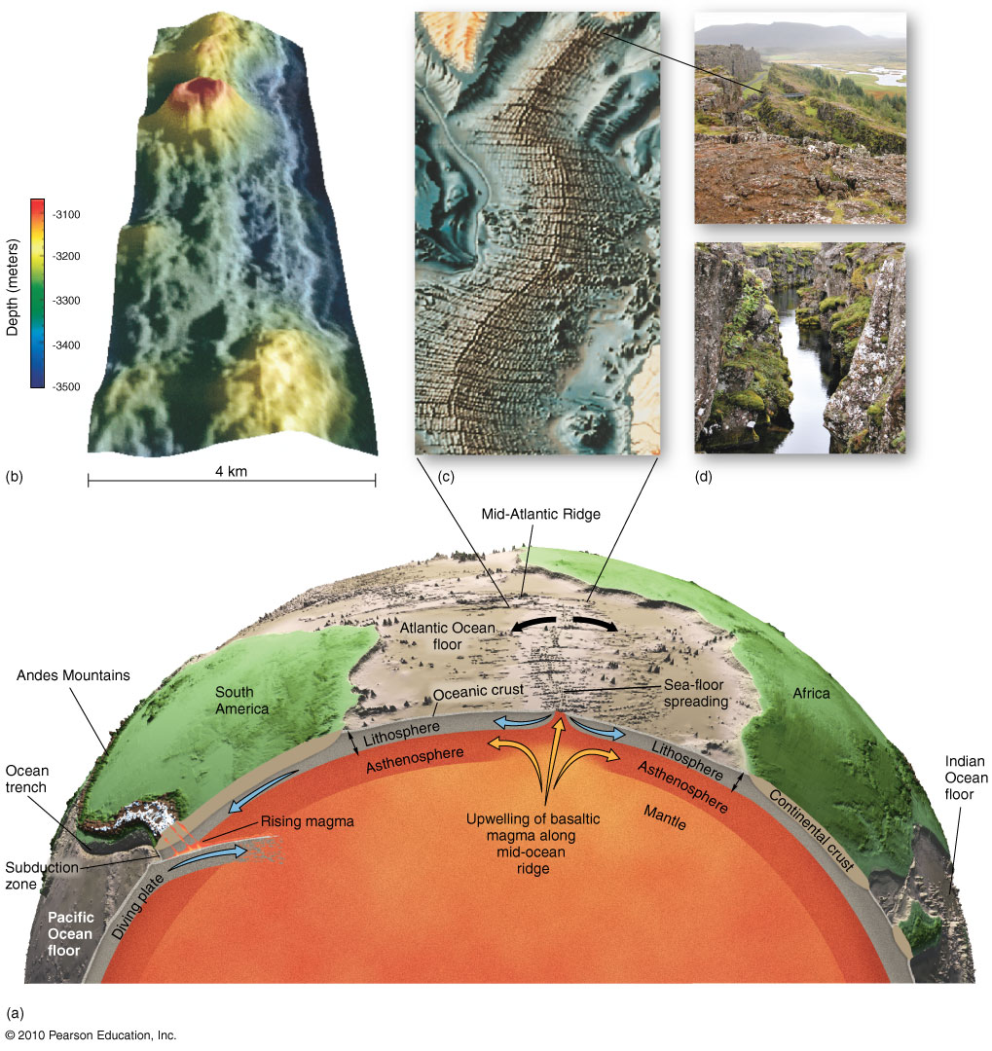
Crustal Movements
Figure 8.13
Christopherson, Elemental Geosystems, Sixth Edition
Copyright © 2010 Pearson Education, Inc.

Slide 50
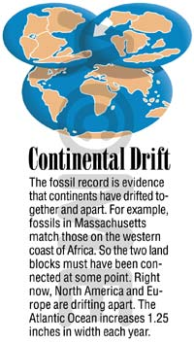
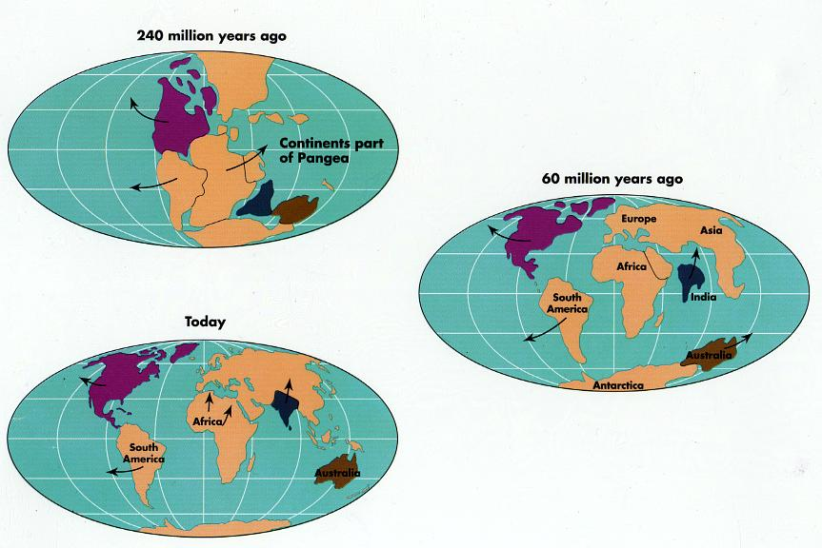

Slide 51
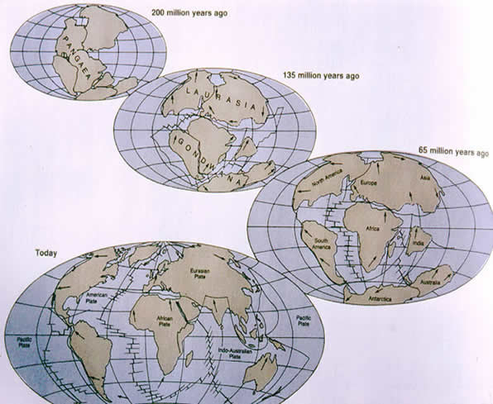
Formation and breakup
of Pangaea

Slide 52
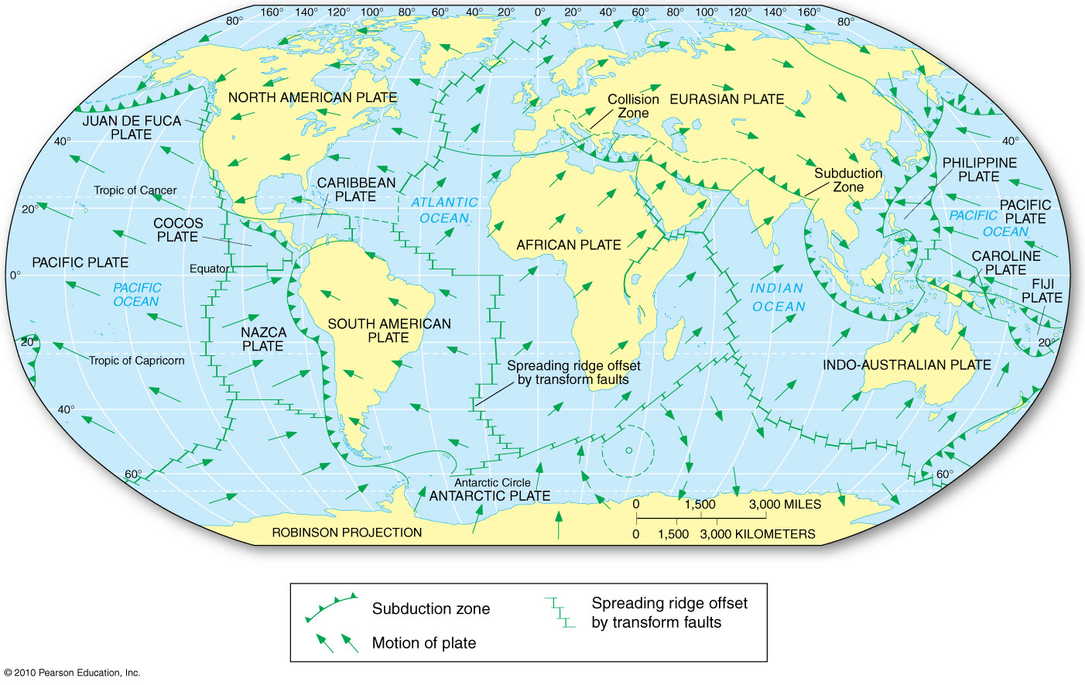
Earth’s Major Plates
Figure 8.16
Christopherson, Elemental Geosystems, Sixth Edition
Copyright © 2010 Pearson Education, Inc.

Slide 53
Plate Boundaries
Divergent plate boundaries
Plates move away from each other; spreading centers
Transform fault boundaries
Plates slide by each other horizontally
Convergent boundaries
Plates move towards each other; subduction zones
Plate collisions can cause earthquakes along faults

Slide 54
Divergent Plate Boundaries
Most are located along the crests of oceanic ridges and can be thought of as constructive plate margins
Plates move away from each other
Oceanic ridges and seafloor spreading
Along well-developed divergent plate boundaries, the seafloor is elevated forming oceanic ridges

Slide 55
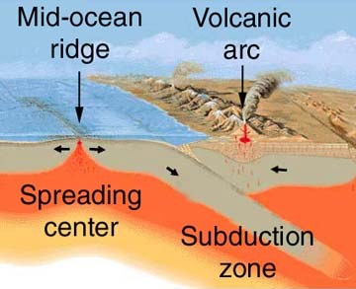
Oceanic
crust
Continental
crust

Slide 56
Convergent Plate Boundaries
Older portions of oceanic plates are returned to the mantle in these destructive plate margins
Surface expression of the descending plate is an ocean trench
Called subduction zones
Average angle at which oceanic lithosphere descends into the mantle is about 45°

Slide 57
Convergent Plate Boundaries
Convergent plates can cause deep-sea trenches and continental-scale mountain ranges
Heavy, but thin, oceanic crust tends to be forced under continental crust
Deep trenches form at these subduction zones
Volcanoes and earthquakes are common in subduction zones
For example, the Ring of Fire

Slide 58
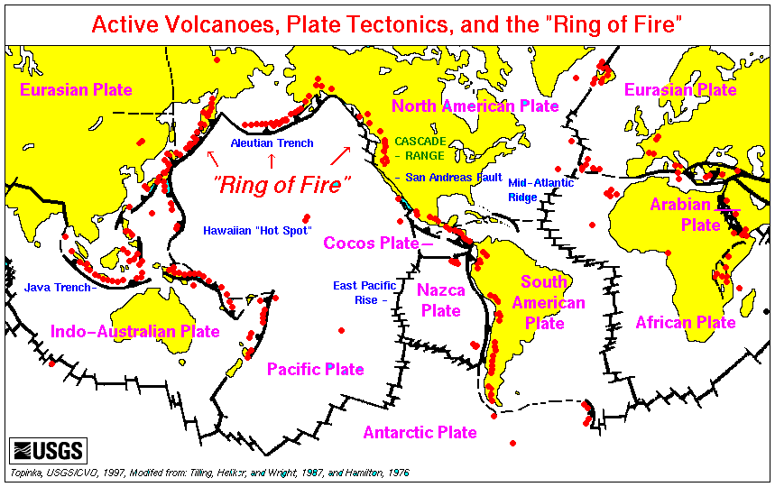

Slide 59
Transform Fault Boundaries
The third type of plate boundary
Plates slide past one another and no new lithosphere is created or destroyed
Because the edges of the plates are rough, they can catch and "stick," allowing stress to build
When this stress is released suddenly, earthquakes may occur

Slide 60
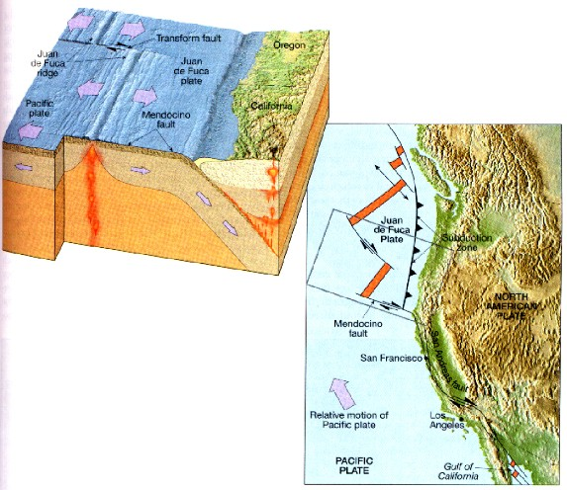
Transform boundaries –
Plates slide pass each
other

Slide 61
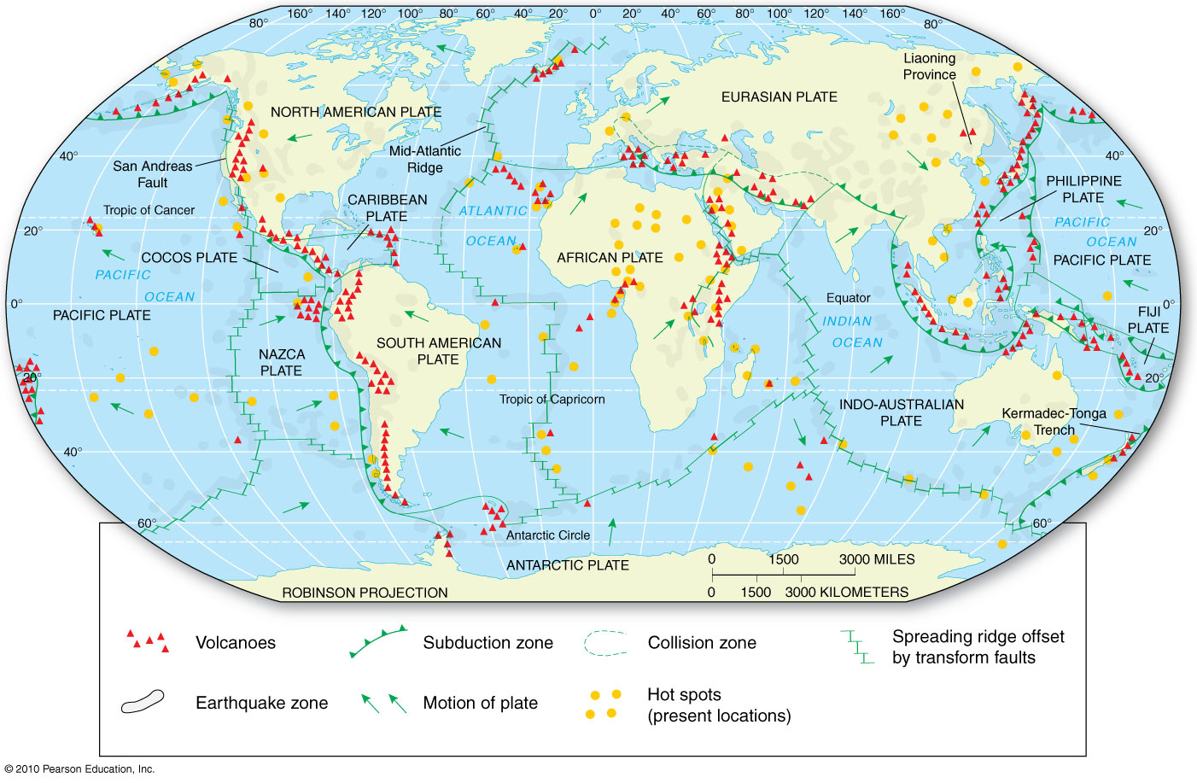
Earthquakes and Volcanoes
Figure 8.18
Christopherson, Elemental Geosystems, Sixth Edition
Copyright © 2010 Pearson Education, Inc.

Slide 62
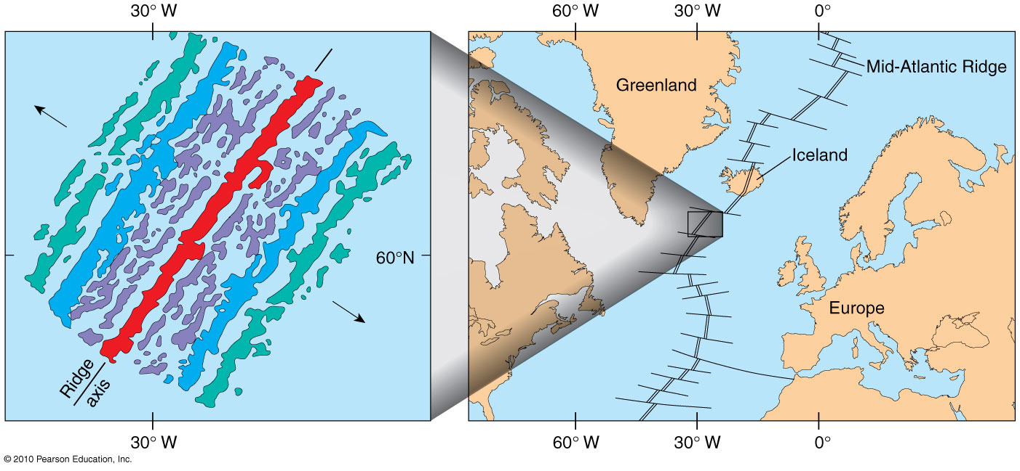
Magnetic Reversals
Figure 8.14

Slide 63
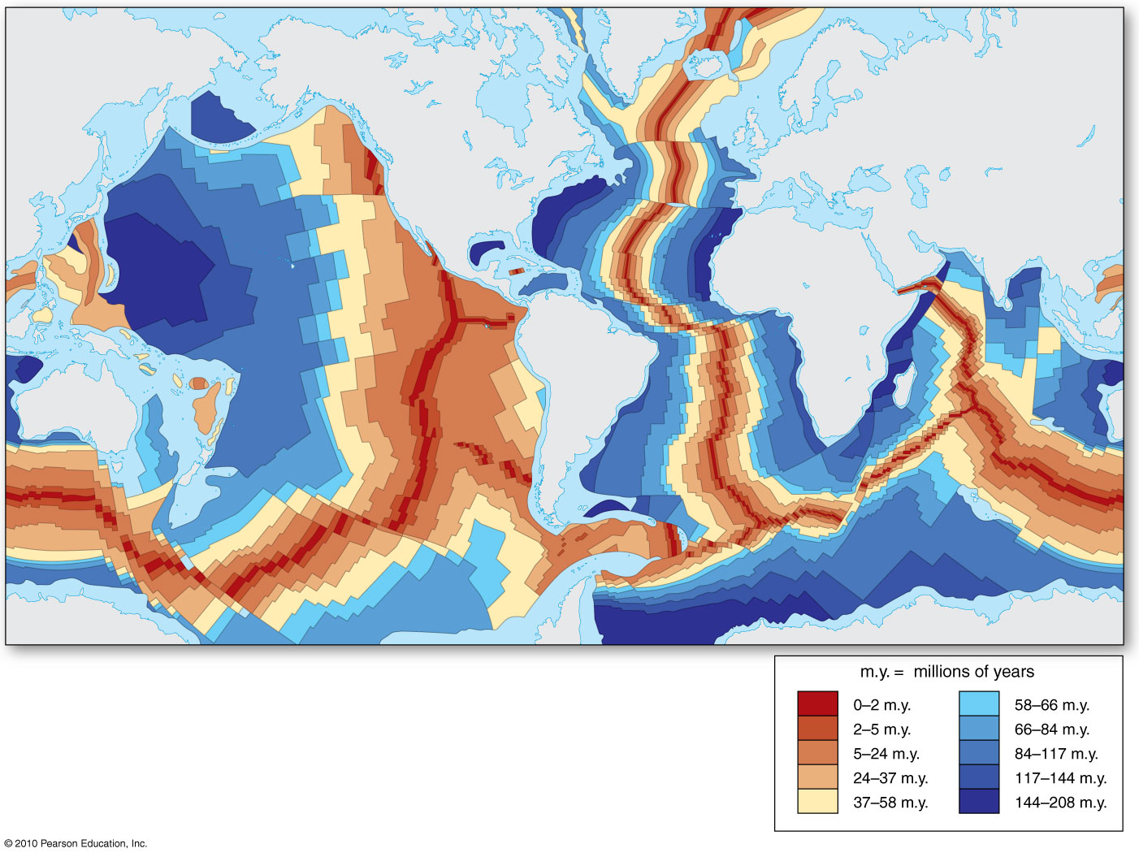
Relative Age of Oceanic Crust
Figure 8.17
Christopherson, Elemental Geosystems, Sixth Edition
Copyright © 2010 Pearson Education, Inc.

Slide 64
Testing the Plate Tectonics Model
Hot Spots
Caused by rising plumes of mantle material
Volcanoes can form over mantle plumes (Hawaiian Island chain)
Most mantle plumes are long-lived structures and at least some originate at great depth, perhaps at the mantle-core boundary

Slide 65
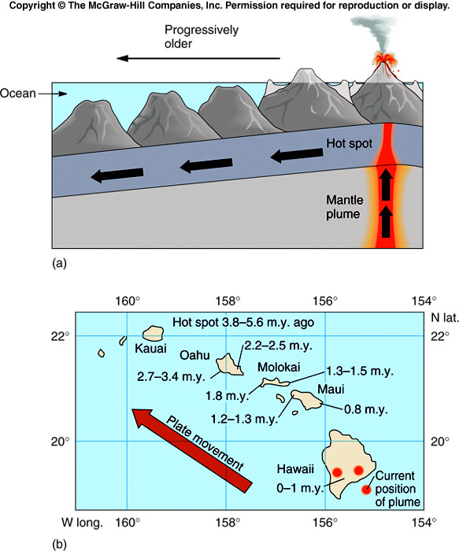
Hot spots or plumes
rise beneath the
Center of Oceanic
plates
Plumes
hot magma from
the mantle rising
toward the surface.
Immovable
Plates move over
hotspots
Islands of Hawaii

Slide 66
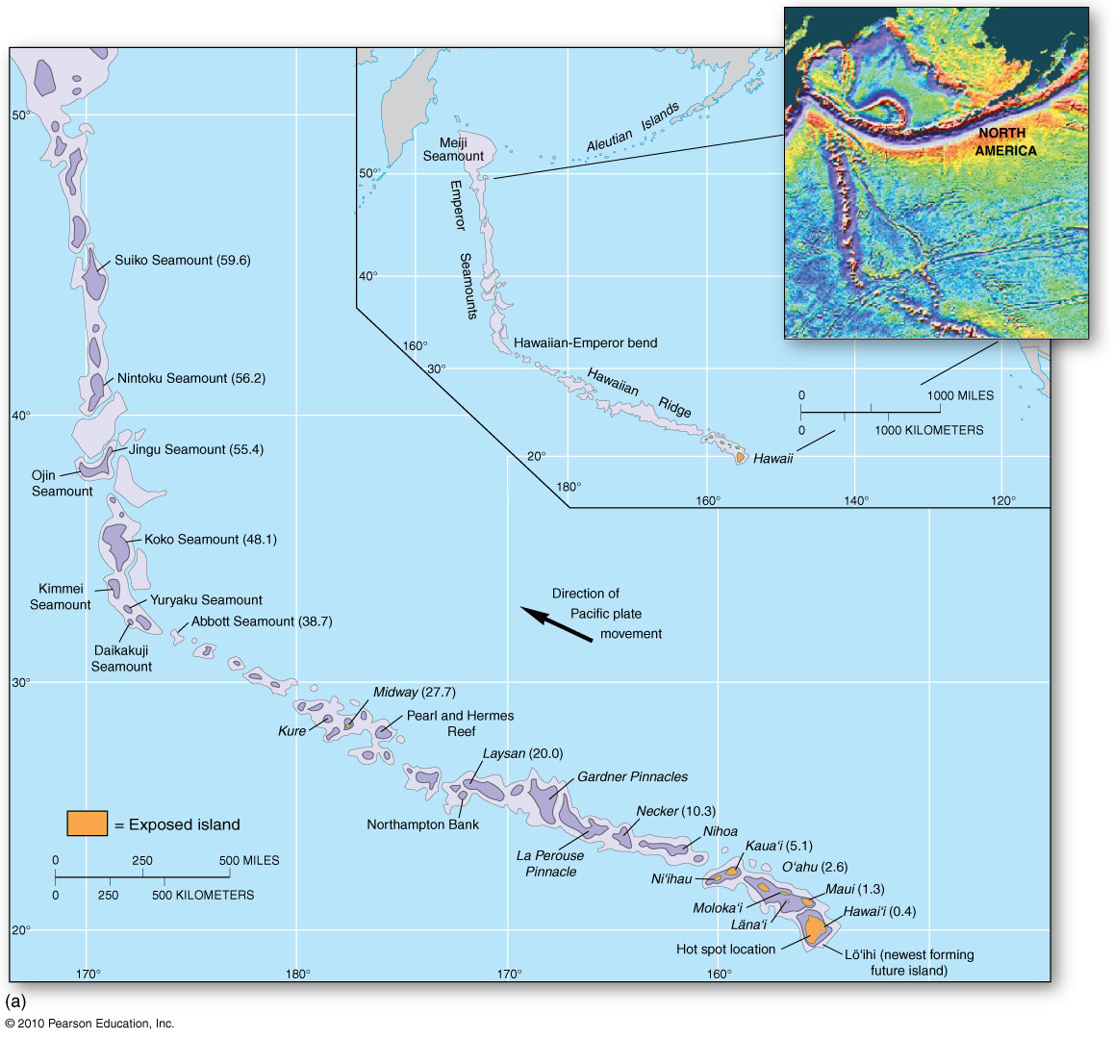
Hot Spot Tracks
Figure 8.19
Christopherson, Elemental Geosystems, Sixth Edition
Copyright © 2010 Pearson Education, Inc.

